Slide 1
LINQ
Information Processing techniques
Week 14

Slide 2
What is LINQ?
Language Integrated Query
Make query a part of the language
Component of .NET Framework 3.5
Notes:
Key feature of C# 3.0 and VB 9

Slide 3
Query without LINQ
Objects using loops and conditions foreach(Customer c in customers) if (c.Region == “PAK") ...
Databases using SQL SELECT * FROM Customers WHERE Region=‘PAK'
XML using XPath/XQuery //Customers/Customer[@Region=‘PAK']
Notes:
This is the situation today, a different language for each technology.

Slide 4
LINQ to…
LINQ to Objects
LINQ to SQL (formerly known as DLINQ)
LINQ to XML (formerly known as XLINQ)
LINQ to Entities (ADO.NET Entities)

Slide 5
Example
You have the following array. Return all numbers which are greater then 4.
Int[] Values = { 2,9,5,0,3,7,1,4,8,6};
Var filtered = from value in Values where value > 4 select value

Slide 6
Example (Sorting)
The LINQ query in the above example selects the elements of the array values and returns an IEnumerable object containing a sorted copy of the elements.
Int[] Values = { 2,9,5,0,3,7,1,4,8,6};
Var filtered = from value in Values Order By value select value

Slide 7
Query with LINQ (C#)
var myCustomers = from c in customers where c.Region == “PAK" select c;
Notes:
This is the same query in LINQ. You'll notice that the syntax is similar to SQL but with the select last. This is to facilitate IntelliSense - it needs to know what you are selecting from before it can offer what is available within that selection.

Slide 8
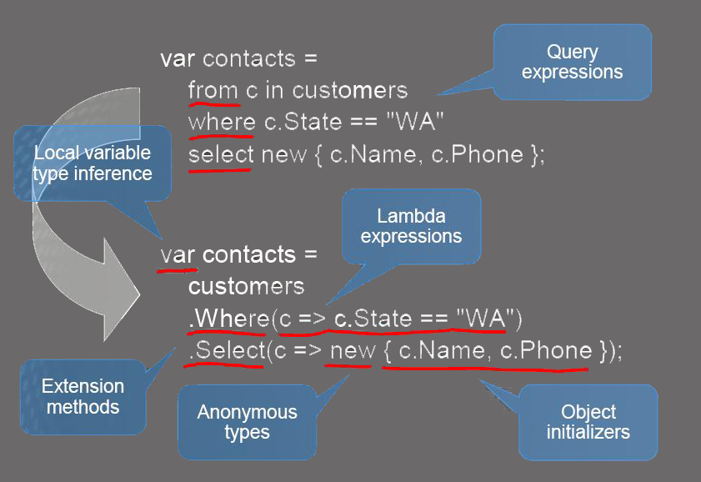
LINQ Prerequisite

Slide 9
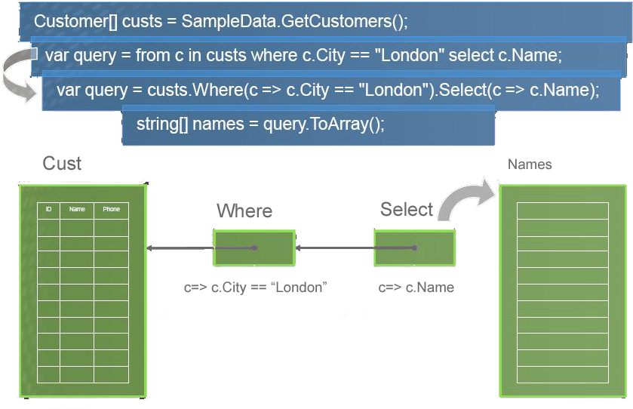
Deferred Query Execution

Slide 10
More LINQ queries
var goodCusts = (from c in db.Customers where c.PostCode.StartsWith(“PK") orderby c.Sales descending select c).Skip(10).Take(10);

Slide 11
Architecture
C#
VB.NET
Others
.NET Language Integrated Query (LINQ)
LINQ data source providers
ADO.NET support for LINQ
LINQ to Objects
LINQ to Datasets
LINQ to SQL
LINQ to Entities
LINQ to XML

Slide 12
LINQ to Objects
Query any IEnumerable<T> source Includes arrays, List<T>, Dictionary...
Many useful operators available Sum, Max, Min, Distinct, Intersect, Union
Expose your own data with IEnumerable<T> or IQueryable<T>
Create operators using extension methods

Slide 13
LINQ to Objects
int[] nums = new int[] {0,4,2,6,3,8,3,1};
double average = nums.Take(6).Average(); var above = from n in nums where n > average select n;
Notes:
Average of first 6 numbers
And display all numbers above average

Slide 14
Querying an Array of Reference-Type Elements Using LINQ
When you type the name of an IEnumerable object (such as an array or the result of a LINQ query) then type the dot (.) separator, the list of the methods and properties that can be used with that object are shown.
Some of the methods are so-called extension methods.
For example, if you have an array of Doubles called numbers and you want to calculate the average of its values, you can simply call the Average extension method, as in numbers.Average().

Slide 15
LINQ operators
Aggregate | Conversion | Ordering | Partitioning | Sets
Aggregate Average Count Max Min Sum | Cast OfType ToArray ToDictionary ToList ToLookup ToSequence | OrderBy ThenBy Descending Reverse | Skip SkipWhile Take TakeWhile | Concat Distinct Except Intersect Union
and many others

Slide 16
LINQ to SQL (formerly known as Dlinq)
Object-relational mapping Records become strongly-typed objects
Data context is the controller mechanism
Facilitates update, delete & insert
Translates LINQ queries behind the scenes
Type, parameter and injection safe

Slide 17
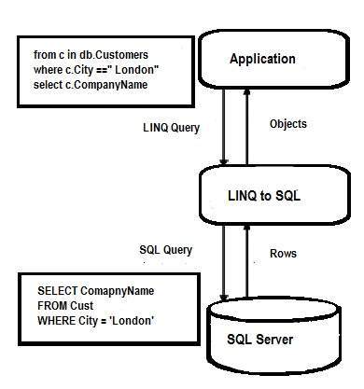
LINQ to SQL (formerly known as Dlinq)

Slide 18
LINQ to SQL (formerly known as Dlinq)
LINQ to SQL translates our actions to SQL and submits the changes to the database.
Step 1: Create a COURSE Table in the database

Slide 19
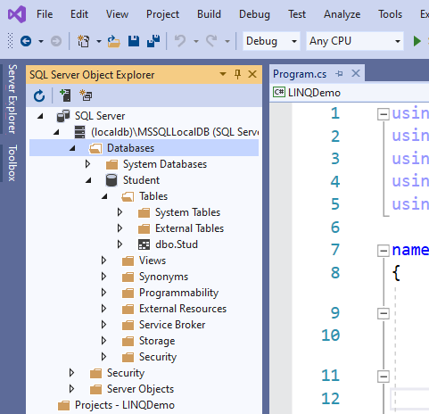
Step 1: Create a Database

Slide 20
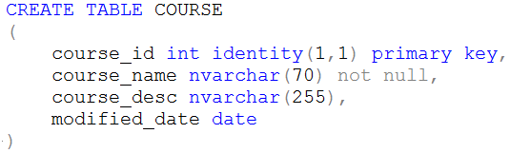
Step 1: Create a Database

Slide 21
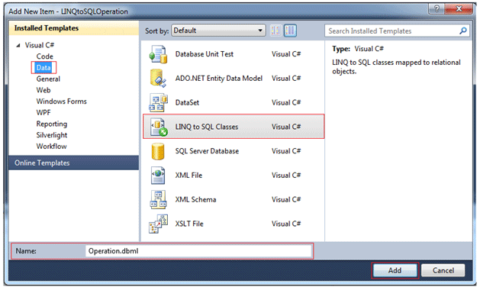
Step 2: Create a ContextData file
Create a new item, select the LINQ to SQL classes (as shown in the following figure) and name it Operation.dbml

Slide 22
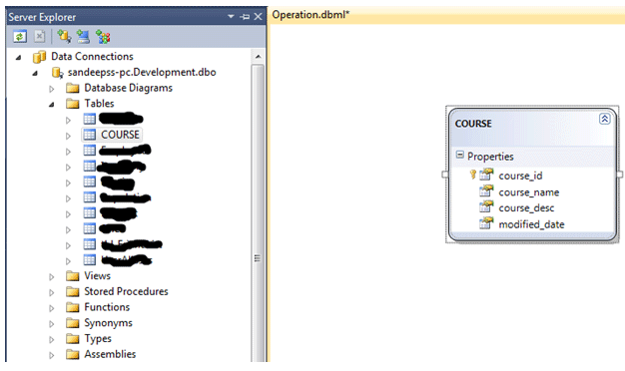
Step 3: Drag tables on Designer
Drag all the tables onto the left-hand side of the designer and save. This will create all the mappings and settings for each table and their entities

Slide 23
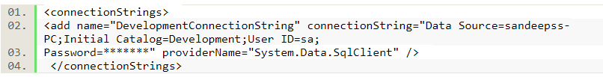
Step 4: Connection String
Connection string is defined in web.config file

Slide 24
Step 4: Connection String
We can use a connection string from the web.config file or we can pass a connection string as a parameter in the constructor of the DataContext class to create an object of the DataContext class.
// In main function
string connectString = System.Configuration.ConfigurationManager.ConnectionStrings["LinqToSQLDBConnectionString"].ToString();
LinqToSQLDataContext db = new LinqToSQLDataContext(connectString);
// rest of your code

Slide 25
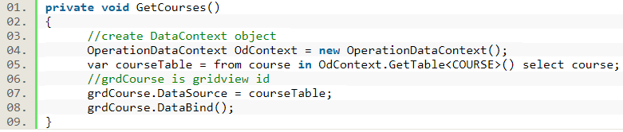
SELECT operation

Slide 26
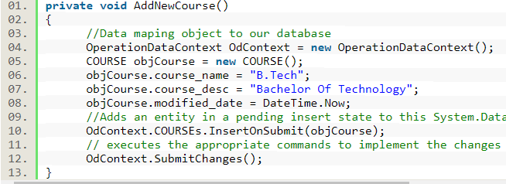
INSERT operation

Slide 27
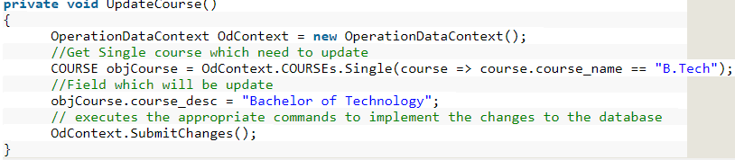
UPDATE operation

Slide 28
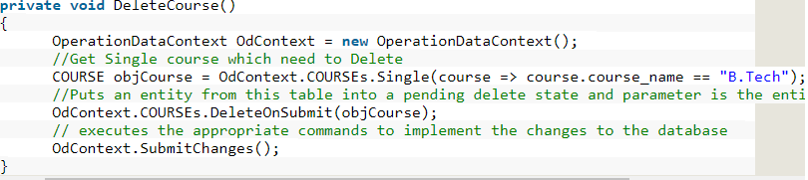
DELETE operation

Slide 29
Advantages
Unified data access Single syntax to learn and remember
Strongly typed Catch errors during compilation
IntelliSense Prompt for syntax and attributes
Bindable result sets

Slide 30
Limitations
LINQ
Only defines query, not update or context
LINQ To SQL
limited to SQL Server as backend
requires at least .NET 3.5 to run
somewhat limited in that tables are mapped strictly on a 1:1 basis (one table = one class)

Slide 31
.NET features used
.NET Framework 2.0
Partial classes (mapping)
.NET Framework 3.5
Anonymous types (shaping)
Extension methods (query operators)
Type inference (var keyword)
Lambda expressions (query syntax)

Slide 32
LINQ to XML
XElement xelement = XElement.Load("..\\..\\Employees.xml");
IEnumerable<XElement> employees = xelement.Elements();
// Read the entire XML
foreach (var employee in employees)
{
Console.WriteLine(employee);
}

